Slide 1
GUI PROGRAMMING
Python provides various options for developing graphical user interfaces (GUIs).
Tkinter: Tkinter is the Python interface to the Tk GUI toolkit shipped with Python.
wxPython: This is an open-source Python interface for wxWindows http://wxpython.org.
JPython: JPython is a Python port for Java which gives Python scripts seamless access to Java class libraries on the local machine http://www.jython.org.

Slide 2
Tkinter Programming
Tkinter is the standard GUI library for Python.
Python when combined with Tkinter provides a fast and easy way to create GUI applications.
Creating a GUI application using Tkinter is an easy task.
Import the Tkinter module.
Create the GUI application main window.
Add one or more of the above-mentioned widgets to the GUI application.

Slide 3
Program
#!/usr/bin/python
import Tkinter
top = Tkinter.Tk()
# Code to add widgets will go here...
top.mainloop()

Slide 4
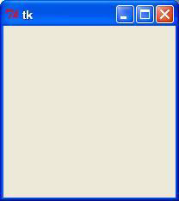
Output

Slide 5
Tkinter Widgets
Tkinter provides various controls, such as buttons, labels and text boxes used in a GUI application.
These controls are commonly called widgets.
There are currently 15 types of widgets in Tkinter.

Slide 6
1. Button
The Button widget is used to add buttons in a Python application.
These buttons can display text or images that convey the purpose of the buttons.
Syntax
w = Button ( master, option=value, ... )
master: This represents the parent window.
options: Here is the list of most commonly used options for this widget.

Slide 7
Program
import Tkinter
import tkMessageBox
top = Tkinter.Tk()
def helloCallBack():
tkMessageBox.showinfo( "Hello Python", "Hello World")
B = Tkinter.Button(top, text ="Hello", command = helloCallBack)
B.pack()
top.mainloop()

Slide 8
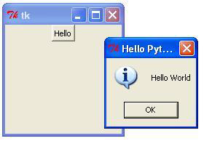
Output

Slide 9
Canvas
The Canvas is a rectangular area intended for drawing pictures or other complex layouts.
You can place graphics, text, widgets2. or frames on a Canvas.
Syntax
w = Canvas ( master, option=value, ... )

Slide 10
Program
import Tkinter
import tkMessageBox
top = Tkinter.Tk()
C = Tkinter.Canvas(top, bg="blue", height=250, width=300)
coord = 10, 50, 240, 210
arc = C.create_arc(coord, start=0, extent=150, fill="red")
C.pack()
top.mainloop()

Slide 11
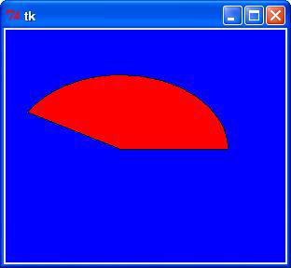
Output

Slide 12
Checkbutton
The Checkbutton widget is used to display a number of options to a user as toggle buttons.
The user can then select one or more options by clicking the button corresponding to each option.
Syntax
w = Checkbutton ( master, option, ... )

Slide 13
Program
from Tkinter import *
import tkMessageBox
import Tkinter
top = Tkinter.Tk()
CheckVar1 = IntVar()
CheckVar2 = IntVar()
C1 = Checkbutton(top, text = "Music", variable = CheckVar1, \
onvalue = 1, offvalue = 0, height=5, \
width = 20)
C2 = Checkbutton(top, text = "Video", variable = CheckVar2, \
onvalue = 1, offvalue = 0, height=5, \
width = 20)
C1.pack()
C2.pack()
top.mainloop()

Slide 14
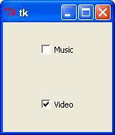
Output

Slide 15
Entry
If you want to display multiple lines of text that can be edited, then you should use the Text widget.
If you want to display one or more lines of text that cannot be modified by the user, then you should use the Label widget.
Syntax
w = Entry( master, option, ... )

Slide 16
Program
from Tkinter import *
top = Tk()
L1 = Label(top, text="User Name")
L1.pack( side = LEFT)
E1 = Entry(top, bd =5)
E1.pack(side = RIGHT)
top.mainloop()

Slide 17

Output

Slide 18
Frame
The Frame widget is very important for the process of grouping and organizing other widgets in a somehow friendly way.
It works like a container, which is responsible for arranging the position of other widgets.
Syntax
w = Frame ( master, option, ... )

Slide 19
Output
from Tkinter import *
root = Tk()
frame = Frame(root)
frame.pack()
bottomframe = Frame(root)
bottomframe.pack( side = BOTTOM )
redbutton = Button(frame, text="Red", fg="red")
redbutton.pack( side = LEFT)
greenbutton = Button(frame, text="Brown", fg="brown")
greenbutton.pack( side = LEFT )
bluebutton = Button(frame, text="Blue", fg="blue")
bluebutton.pack( side = LEFT )
blackbutton = Button(bottomframe, text="Black", fg="black")
blackbutton.pack( side = BOTTOM)
root.mainloop()

Slide 20

Output

Slide 21
Label
This widget implements a display box where you can place text or images. The text displayed by this widget can be updated at any time you want.
It is also possible to underline part of the text (like to identify a keyboard shortcut) and span the text across multiple lines.
Syntax
w = Label ( master, option, ... )

Slide 22
Program
from Tkinter import *
root = Tk()
var = StringVar()
label = Label( root, textvariable=var, relief=RAISED )
var.set("Hey!? How are you doing?")
label.pack()
root.mainloop()

Slide 23

Output

Slide 24
Listbox
The Listbox widget is used to display a list of items from which a user can select a number of items.
Syntax
w = Listbox ( master, option, ... )

Slide 25
Listbox
from Tkinter import *
import tkMessageBox
import Tkinter
top = Tk()
Lb1 = Listbox(top)
Lb1.insert(1, "Python")
Lb1.insert(2, "Perl")
Lb1.insert(3, "C")
Lb1.insert(4, "PHP")
Lb1.insert(5, "JSP")
Lb1.insert(6, "Ruby")
Lb1.pack()
top.mainloop()

Slide 26
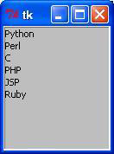
Output

